Slide 1





CIBRIX - AI HACKATHON
TEAM: DIGITAL DREAMWEAVERS
MIDDLE EAST COLLEGE
DESERT LENS – AN AI-POWERED INFRASTRUCTURE & TERRAIN ANALYSIS SYSTEM
Exploring innovations that will shape our world tomorrow.

Slide 2
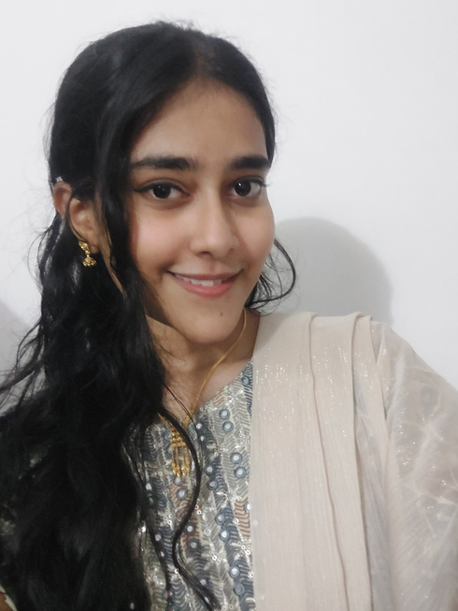
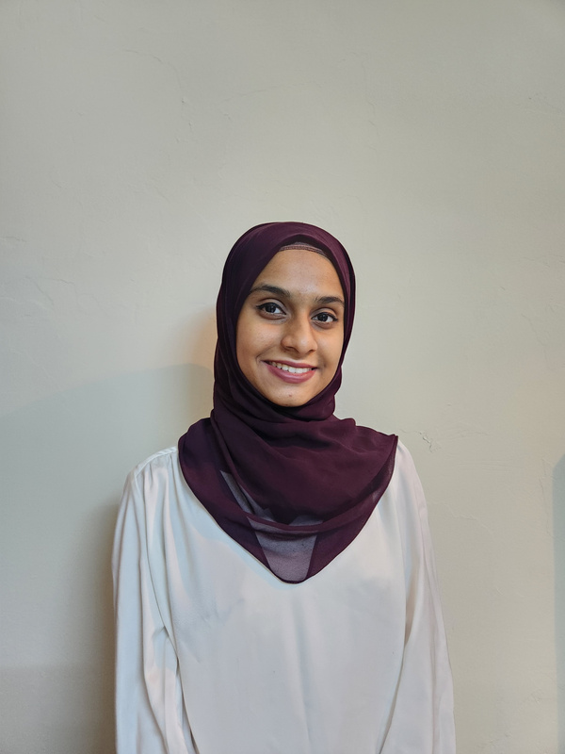
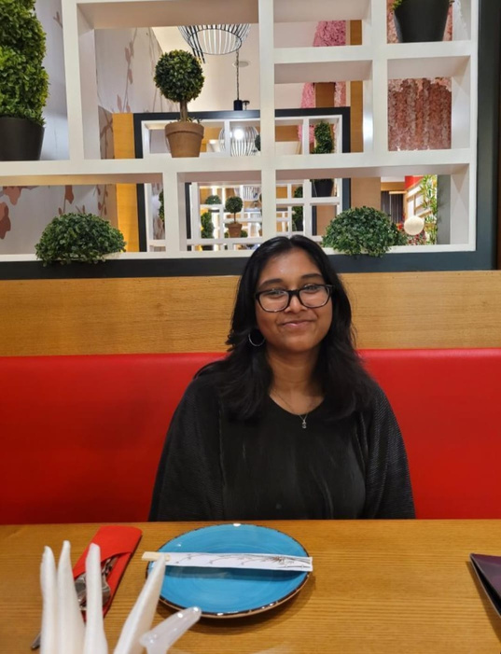
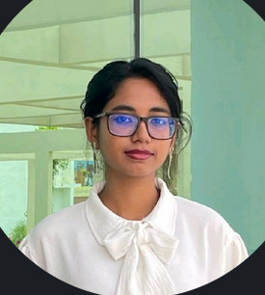
CIBRIX AI Hackathon
DIGITAL DREAMWEAVERS - TEAM
FATHIMA HASNA ZAINULABDEEN
FAYZA AZMIN ISHRA
MEGHA JAYAMOHAN
NISHPA DAS

Slide 3
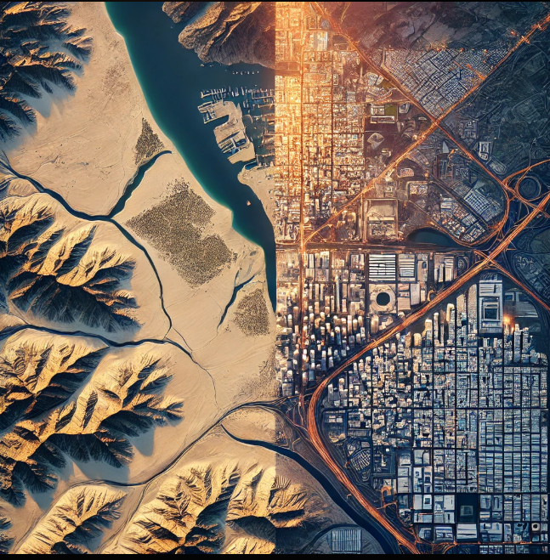
CIBRIX AI Hackathon
PROBLEM STATEMENT
Rapid urbanization in Oman is causing land degradation and environmental harm. Traditional methods are inefficient. There is a need for the preservation of biodiversity and practice sustainable development. This project uses AI and deep learning to analyze real-time satellite and drone images, enabling policymakers to track urban growth, assess deserted areas, and plan sustainable cities with automated, data-driven solutions.

Slide 4

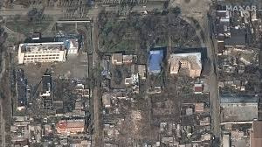
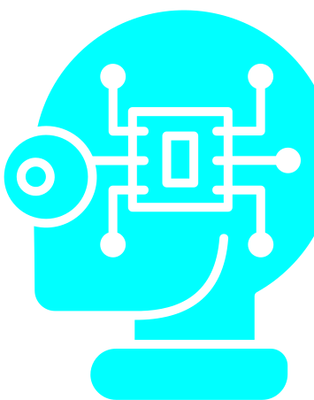

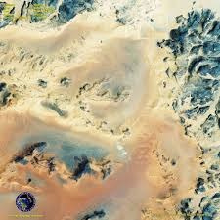
CIBRIX AI Hackathon
DATASET
1.
Dataset Used:
2.
AI Model - CNN (Convolutional Neural Network)
Satellite images
Binary image classification
Specializes in image recognition and classification
Satellite images 🛰️ (classifying land as infrastructure vs. natural terrain)
Drone images 🚁 (detecting urban expansion in deserts/mountains)
Topographical maps 🏔️ (predicting land suitability for development)
Urban Area
Benefits of a CNN Model:
Feature Extraction
High Accuracy in Image Classification
Scalability
Automation and Real-time Monitoring
Desert

Slide 5
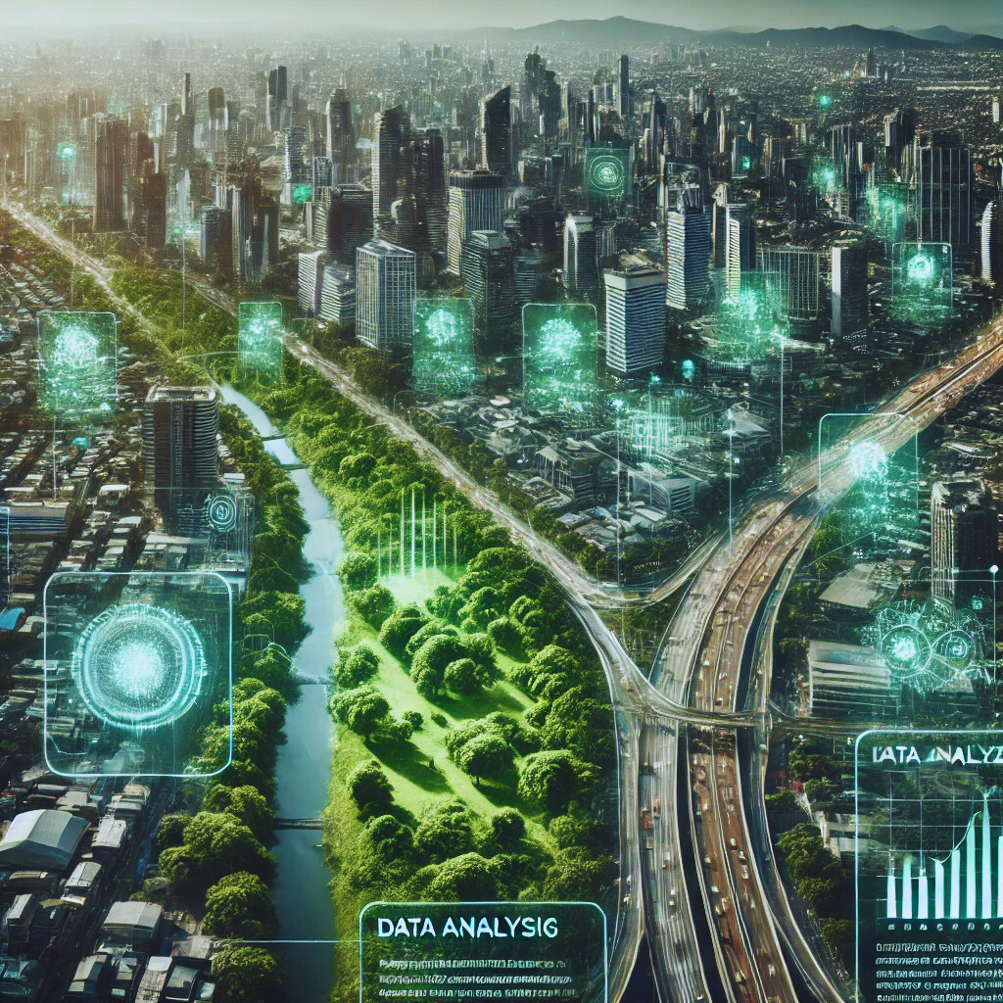
CIBRIX AI Hackathon
REAL-WORLD APPLICATION
Promotion of Tourism and Preservation of Culture
Sustainable Infrastructure Planning
Climate Impact Analysis
Renewable Energy Site Selection
Disaster Management
Autonomous Drones & Robotics
.

Slide 6


CIBRIX AI Hackathon
ETHICAL RISKS
Environmental and Cultural Sensitivity
Bias in AI Model Training
Data Privacy & Ownership
Misuse of AI Model
SECURITY RISKS
Cybersecurity Threats
Threats to Data Integrity
Attacks on the AI Model

Slide 7

CIBRIX AI Hackathon
IMPLEMENTATION STRATEGY
1.
2.
3.
DATA COLLECTION & PROCESSING
AI MODEL DEVELOPMENT
DEPLOYMENT & INTEGRATION
BUSINESS MODEL
Consulting & Enterprise Solutions for the Government

Slide 8

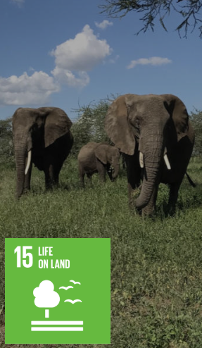
CIBRIX AI Hackathon
SUSTAINABLE DEVELOPMENT GOALS (SDG)
SDG 13
Prevents desertification and protects fragile mountain ecosystems
SDG 15
Use AI to monitor land degradation and promote afforestation

Slide 9
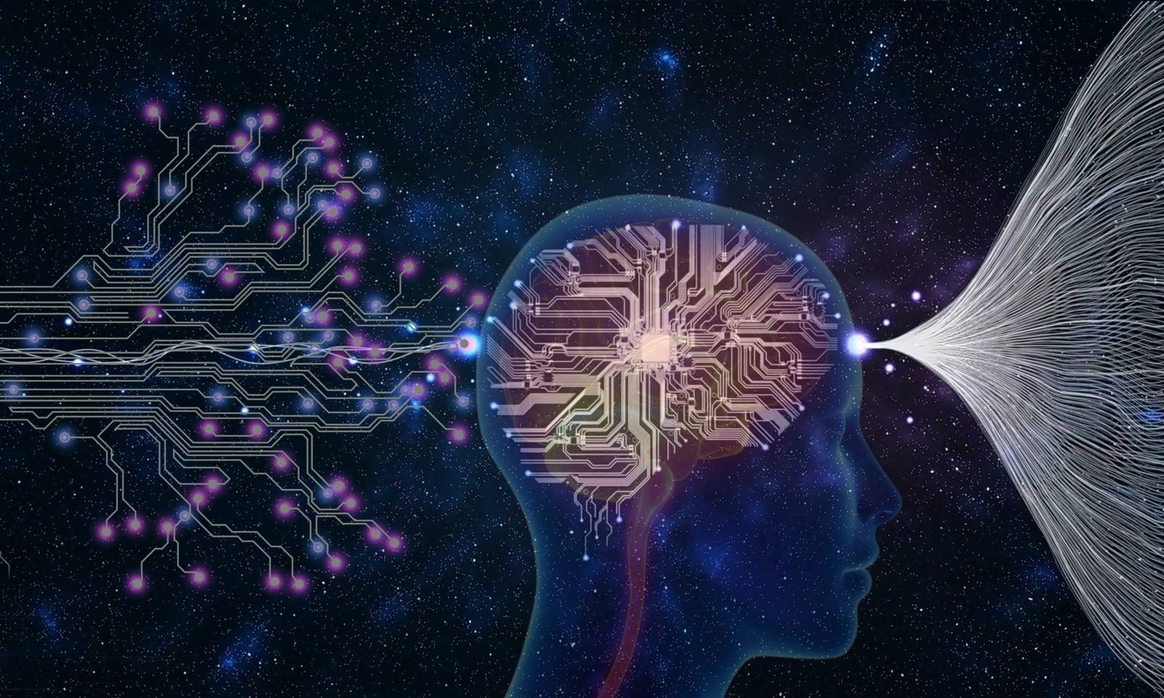
CIBRIX AI Hackathon
PROTOTYPE DEMONSTRATION
Testing Code:
www.testingtime.com

Slide 10
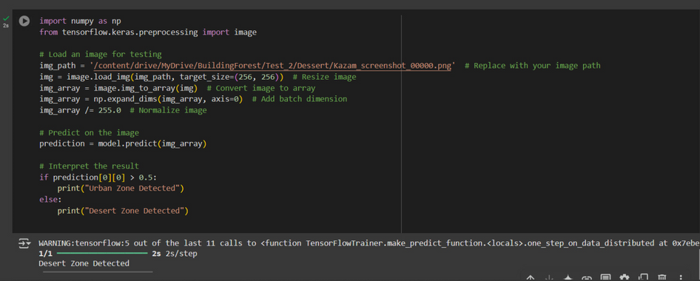
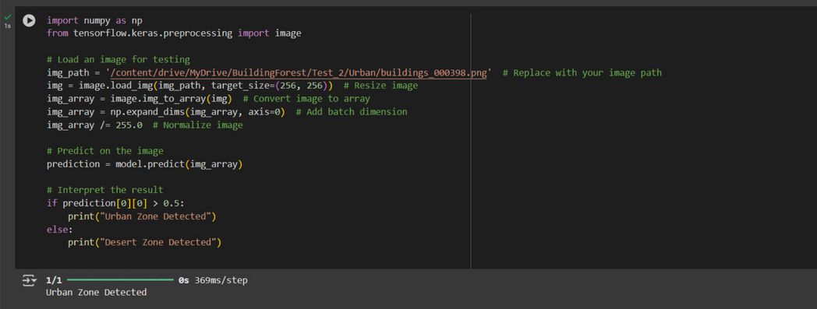
CIBRIX AI Hackathon
RESULT
Desert Zone Detected
Green Zone Detected

Slide 11
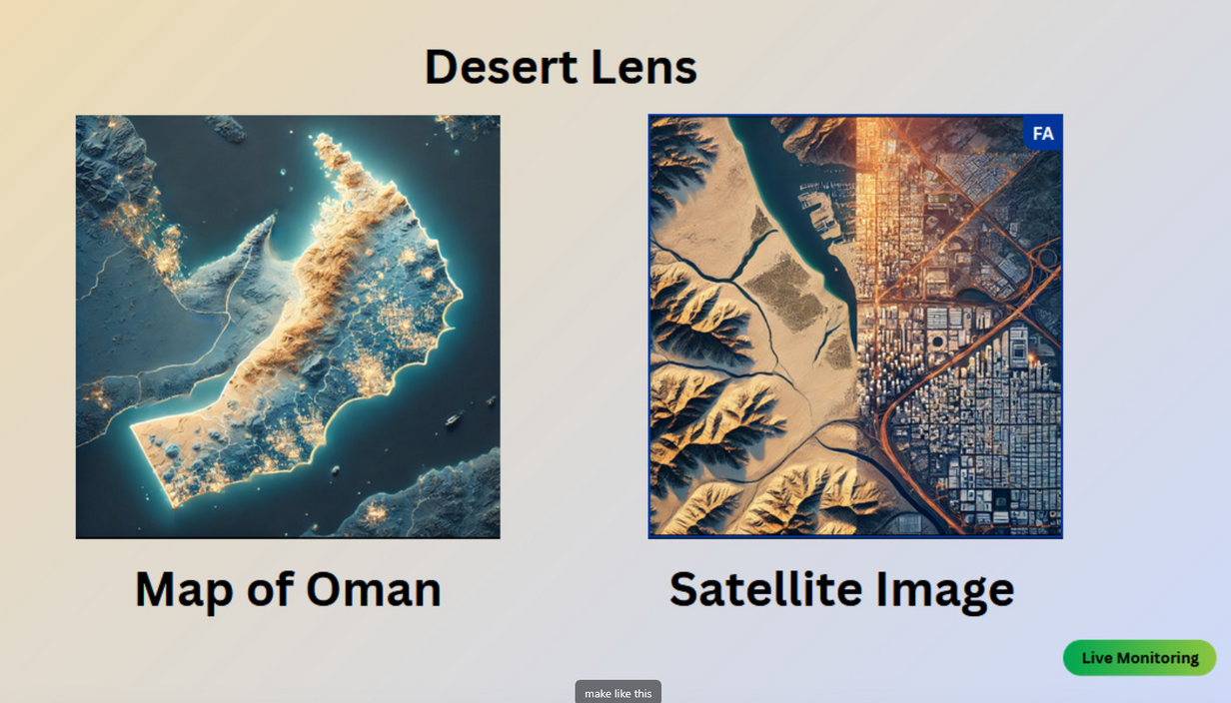
CIBRIX AI Hackathon
RESULT

Slide 12
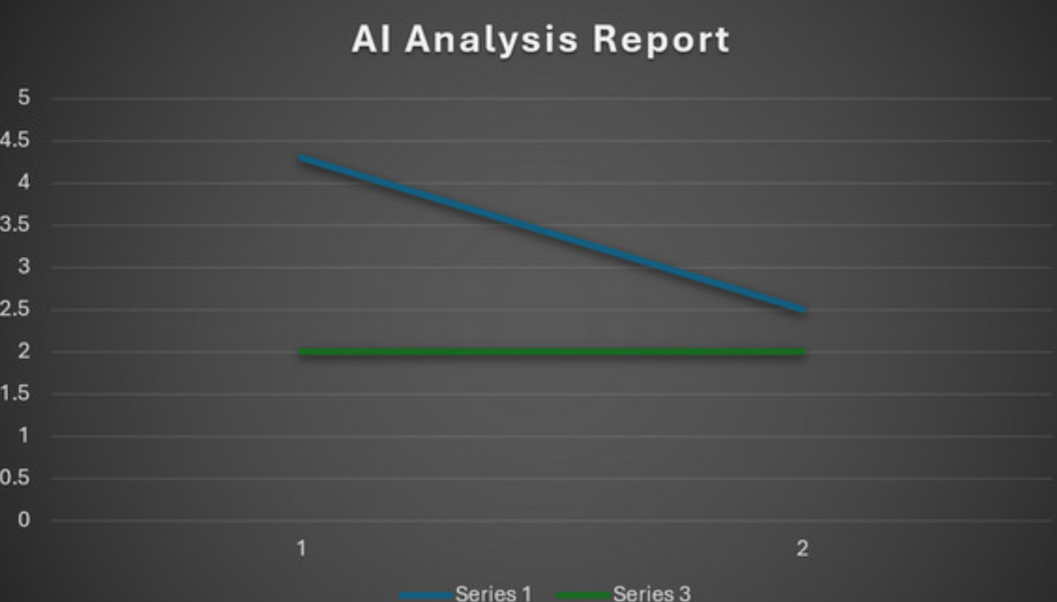
CIBRIX AI Hackathon
VISUAL REPORT

Slide 13
CIBRIX AI Hackathon
OMAN VISION 2040 - ENVIRONMENTAL INTELLIGENCE
1.
2.
3.
Expand renewable energy projects like solar and wind to reduce fossil fuel dependency. It is also improving public transport with smart systems to reduce congestion and emissions while promoting sustainable urban growth with energy-efficient infrastructure and high-quality public services.
Use GIS for urban planning and resource management, to monitor and visualise urban expansion and identify environmental risks like land degradation. It ensures efficient management of land, water, and transport networks for sustainable development.
Leverage technology to monitor air quality, manage water resources, adapt to climate change, protect green spaces thus supporting long-term environmental resilience.

Slide 14

CIBRIX AI Hackathon
TECHNOLOGICAL INTEGRATION
IOT-based climate sensors (weather forecasting)
AI-powered land mapping drones
Urban simulation models
Blockchain - land records (tamper-proof)
Autonomous drones - mountainous areas
Robotic urban maintenance

Slide 15

CIBRIX AI Hackathon
CONCLUSION
Our AI-driven solution enables real-time monitoring of urban expansion and desertification in Oman using deep learning, satellite imagery, and GIS. It empowers planners with data-driven insights for sustainable development. The project can scale to other regions, integrate live data, and support climate adaptation, ensuring a balance between growth and environmental preservation.

Slide 16
CIBRIX AI Hackathon
THANK YOU!
As we look to the future, these technologies will play a crucial role in shaping a better world for generations to come.

